Slide 1
ButtonDemo
MainActivity.kt
activity_main.xml
AndroidManifest.xml

Slide 2
MainActivity.kt
import android.os.Bundle
import android.widget.Button
import android.widget.Toast
class MainActivity: AppCompatActivity() {
override fun onCreate(savedInstanceState: Bundle?) {
super.onCreate(savedInstanceState)
setContentView(R.layout.activity_main)
// Find the button by its ID
val myButton: Button = findViewById(R.id.myButton)
// Set a click listener on the button
myButton.setOnClickListener {
// Code to be executed when the button is clicked
Toast.makeText(this,"Button Clicked", Toast.LENGTH_SHORT).show()
}
}
}

Slide 3
activity_main.xml
<?xml version="1.0" encoding="utf-8"?>
<RelativeLayout
xmlns:android="http://schemas.android.com/apk/res/android"
android:layout_width="match_parent"
android:layout_height="match_parent">
<Button
android:id="@+id/myButton"
android:layout_width="wrap_content"
android:layout_height="wrap_content"
android:text="CLICK ME"
android:layout_gravity="center"/>
</RelativeLayout>

Slide 4
AndroidManifest.xml
<?xml version="1.0" encoding="utf-8"?>
<manifest xmlns:android="http://schemas.android.com/apk/res/android"
xmlns:tools="http://schemas.android.com/tools">
<application
android:allowBackup="true"
android:dataExtractionRules="@xml/data_extraction_rules"
android:fullBackupContent="@xml/backup_rules"
android:icon="@mipmap/ic_launcher"
android:label="@string/app_name"
android:roundIcon="@mipmap/ic_launcher_round"
android:supportsRtl="true"
android:theme="@style/Theme.AppCompat"
tools:targetApi="31">

Slide 5
AndroidManifest.xml
<activity
android:name="MainActivity"
android:exported="true"
android:label="@string/app_name"
android:theme="@style/Theme.AppCompat">
<intent-filter>
<action android:name="android.intent.action.MAIN" />
<category android:name="android.intent.category.LAUNCHER" />
</intent-filter>
</activity>
</application>
</manifest>

Slide 6
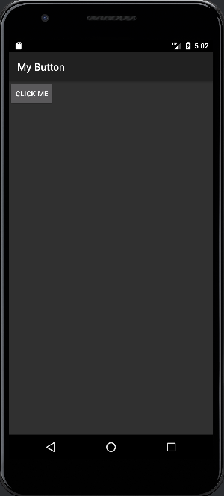
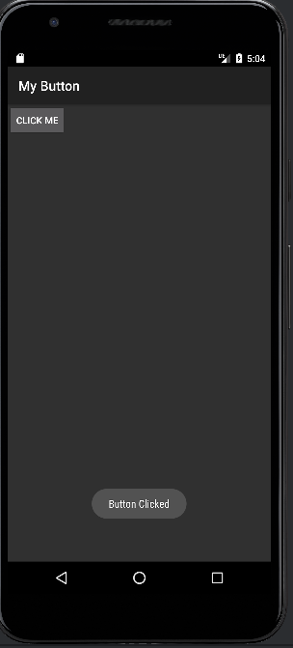
Output:

